Slide 1
Java From Functions to Objects
Università di Modena e Reggio Emilia
Prof. Nicola Bicocchi (nicola.bicocchi@unimore.it)

Slide 2
Why OOP?

Slide 3
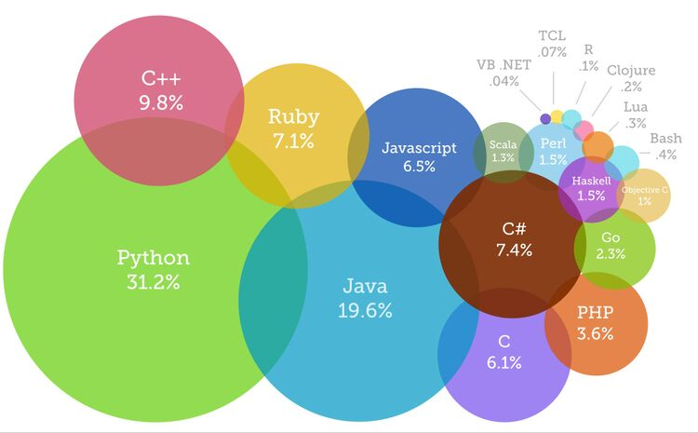
The Present

Slide 4
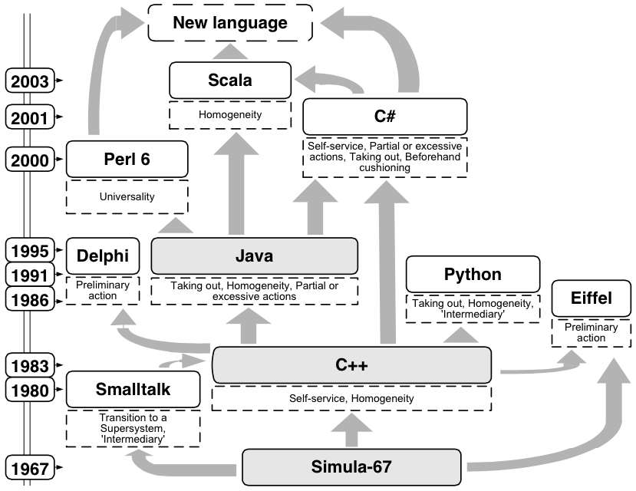
The Past
https://www.youtube.com/watch?v=YqxeLodyyqA

Slide 5


The Future?

Slide 6
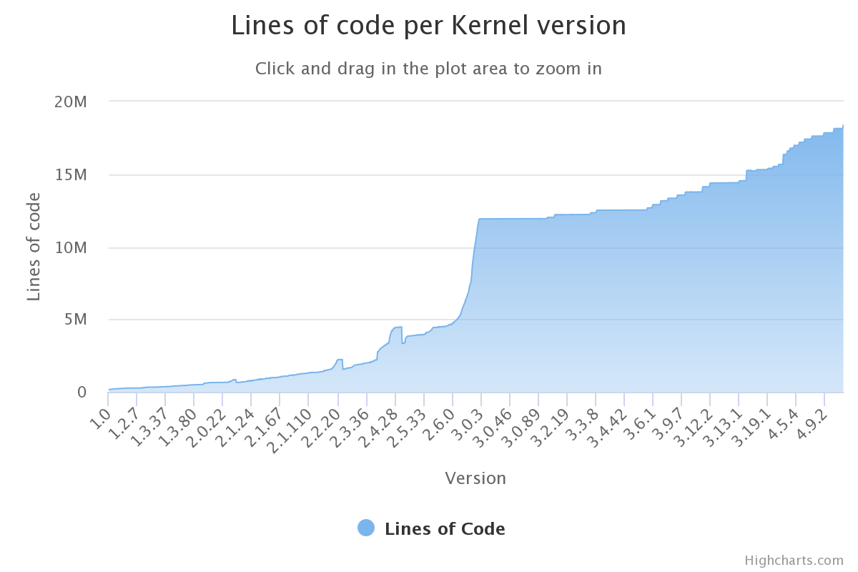
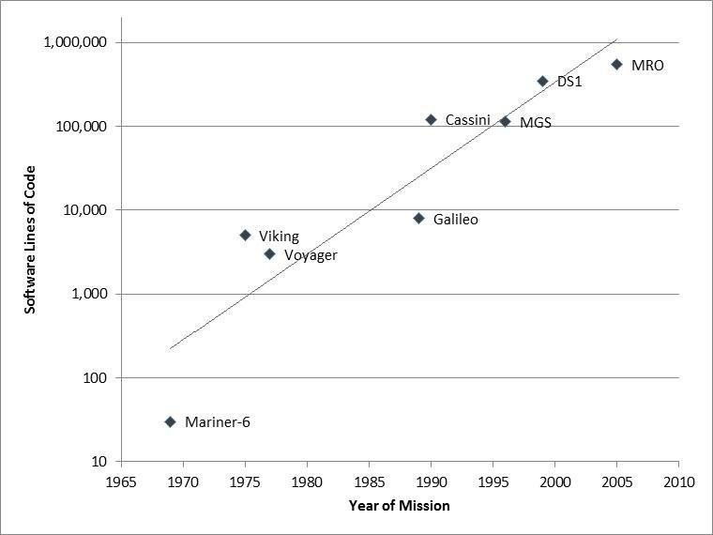
Why OOP?

Slide 7
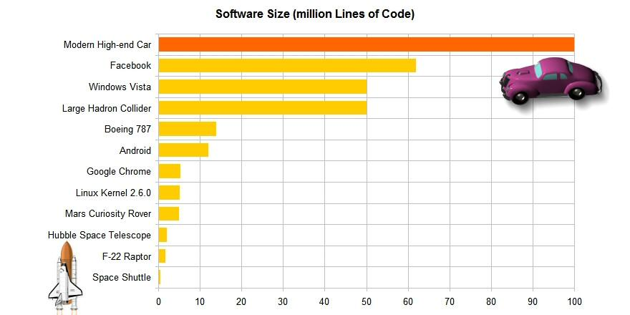
Why OOP?
http://www.informationisbeautiful.net/visualizations/million-lines-of-code/

Slide 8


Why OOP?

Slide 9
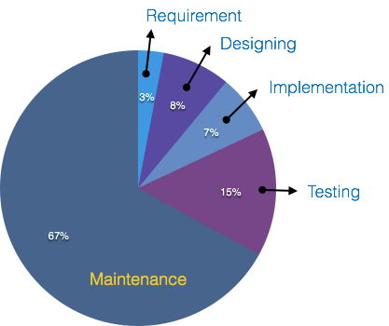
Why OOP?
Procedural programming languages (e.g., Pascal, C) are not suitable for building large software infrastructures
OOP addresses this issue and reduces development and maintenance costs for large and complex software projects
OOP aims at software being secure, re-usable, flexible, documentable, extensible
Instead of focusing on algorithms, optimization and efficiency, OOP focus on programming techniques
OOP considers software as a set of well-defined entities containing both data and functions

Slide 10
Why OOP? (Software crisis)
The causes of the software crisis were linked to the overall complexity of hardware and the software development process. The crisis manifested itself in several ways:
Projects running over-budget
Projects running over-time
Software was inefficient
Software was difficult to maintain
https://en.wikipedia.org/wiki/Software_crisis

Slide 11
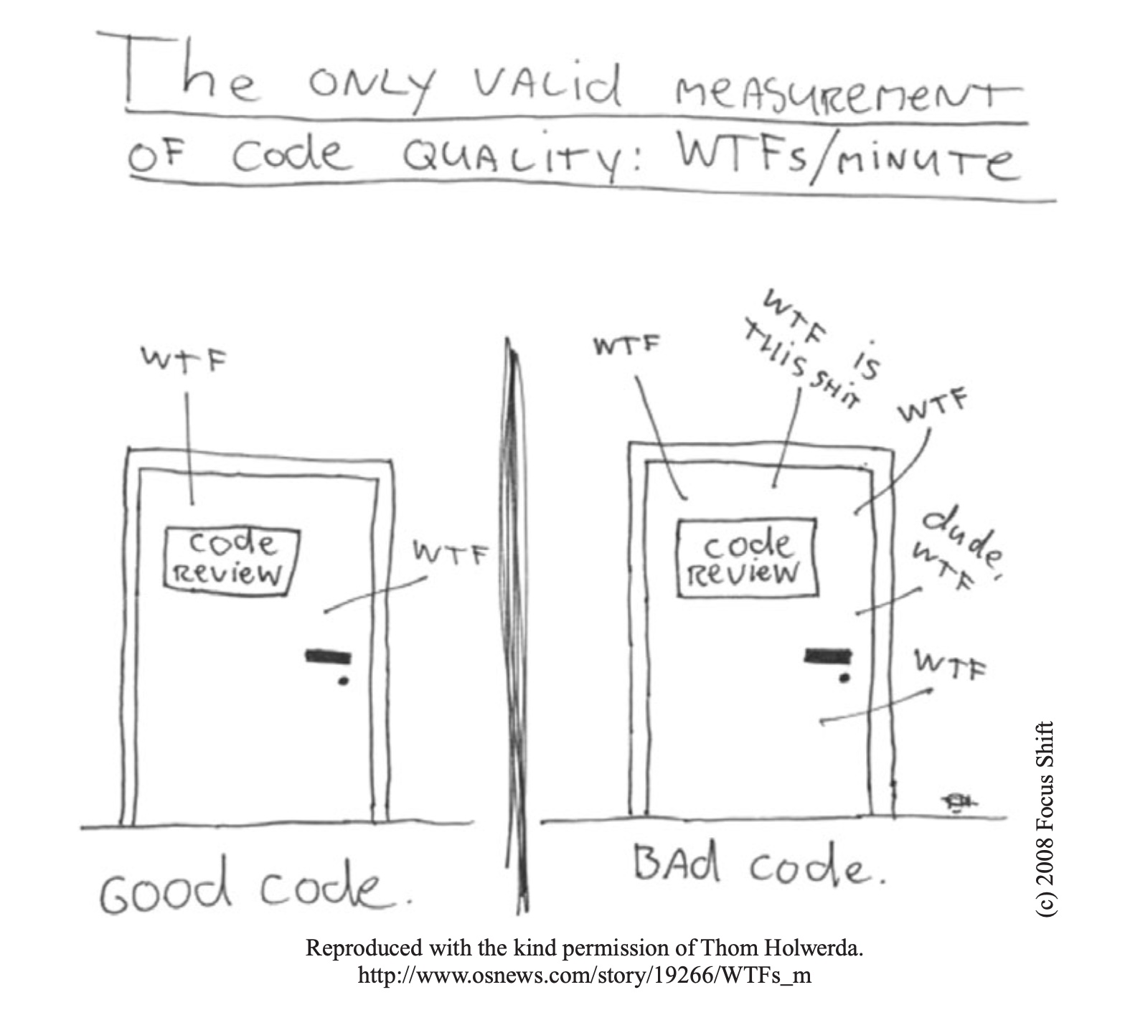
Errors / 1K SLOC
Industry Average
25 errors / 1K SLOC
Corporate Applications
5 errors / 1K SLOC
Cleanroom development technique
0.5 errors / 1K SLOC

Slide 12
Fuctions vs Objects

Slide 13
Procedural approach
#include <stdio.h> #include <stdlib.h> void init(int v[], int size) {
int i;
for (i = 0; i < size; i++) {
v[i] = rand() % 100;
}
}
void sort(int v[], int n) {
int i, j, tmp, changed;
for (i = 0; i < n-1; i++) {
changed = FALSE;
for (j = 0; j < n - i - 1; j++) {
if (v[j] > v[j + 1]) {
changed = TRUE;
tmp = v[j];
v[j] = v[j + 1];
v[j + 1] = tmp;
}
}
if (!changed) break;
}
}
int search(const int v[], int size, int value) {
int i;
for (i = 0; i < size; i++ ) {
if (v[i] == value) {
return i;
}
}
return -1;
}
void show(int v[], int size) {
int i;
for (i = 0; i < size; i++) {
printf("[%d] %d\n", i, v[i]);
}
}
int main() {
int v[100];
int n = sizeof(v) / sizeof(v[0]);
init(v, n);
sort(v, n);
search(v, n, 10);
}

Slide 14
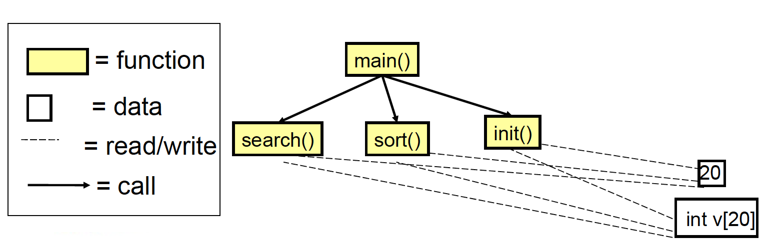
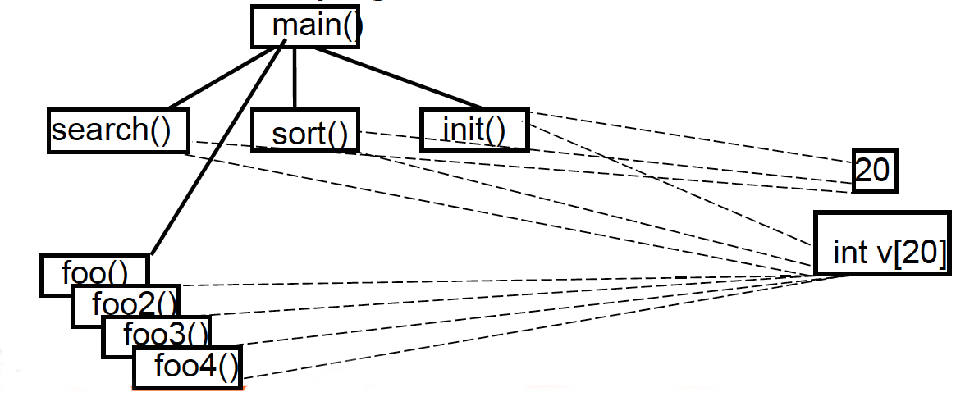
Issues
No clear relationship between
The actual array (int v[20])
Operations on the array (search(), sort(), init())
Need of a dedicated variable for storing the array size
int v[100]; int n = sizeof(v) / sizeof(v[0]);
Initialization not guaranteed
Reuse of code limited
Data and operations are separate. This makes it complex to reuse existing code in other projects
Data protection limited
Unprotected data accessible from vast portions of the source code. After a certain stage, debug becomes a nightmare!
Decomposition limited
Large scale projects require a large scale working force (many teams). Unprotected data, separate from operations, makes it hard to decompose

Slide 15
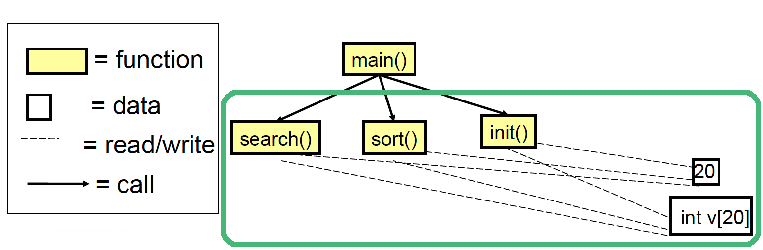
Solution!
Define a new type (a class of special vectors) in which data and operations are modularized together!

Slide 16
Object-Oriented approach
public class Vector {
int[] v;
public Vector(int capacity) {
this.v = new int[capacity];
init();
}
void sort() {
boolean changed;
for (int i = 0; i < v.length-1; i++) {
changed = false;
for (int j=0; j < v.length - i - 1; j++) {
if (v[j] > v[j + 1]) {
changed = true;
int tmp = v[j];
v[j] = v[j + 1];
v[j + 1] = tmp;
}
}
if (!changed) break;
}
}
void init() {
Random rnd = new Random();
for (int i = 0; i < v.length; i++) {
v[i] = rnd.nextInt(100);
}
}
int search(int value) {
for (int i = 0; i < v.length; i++) {
if (v[i] == value) {
return i;
}
}
return -1;
}
void show() {
for (int i = 0; i < v.length; i++) {
System.out.printf("[%d] %d\n", i, v[i]);
}
}
}

Slide 17
OOP Engineering Approach
Procedural Programming
Data and functions are separate
Functions process data
operation(object, params)
int main() {
int v[100];
int n = sizeof(v) / sizeof(v[0]);
init(v, n);
sort(v, n);
search(v, n, 10);
}
Object Oriented Programming
Data and functions are modularized together
Objects deliver services using internal data
object.operation(params)
public static void main(String[] args) {
Vector v = new Vector(20);
v.sort();
v.show();
v.search(10);
}

Slide 18
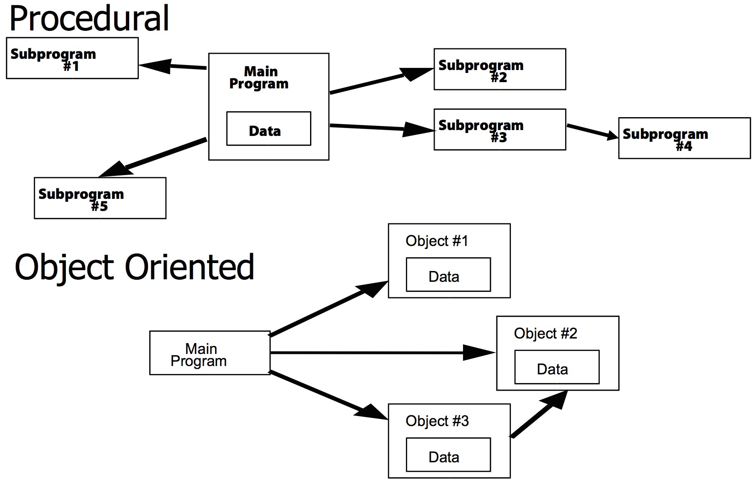
OOP Engineering Approach

Slide 19
OOP Key Features Encapsulation, Inheritance, Polymorphism

Slide 20
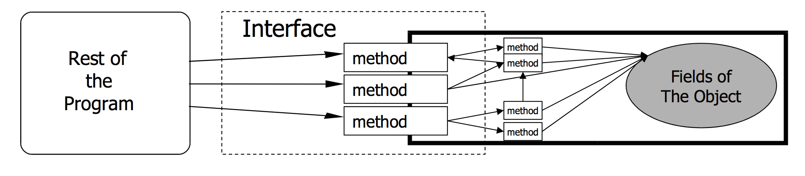
Encapsulation
Encapsulation is defined as the mechanism wrapping together code and data (data is encapsulated inside a shield of code).
Another way to think about encapsulation is a protective shield that prevents the data from being accessed by code outside this shield.

Slide 21
Was it possible before?
// point.h
struct Point;
struct Point* makePoint(double x, double y);
double distance (struct Point *p1, struct Point *p2);
// point.c
#include "point.h"
struct Point {
double x,y;
};
struct Point* makepoint(double x, double y) {
struct Point* p = malloc(sizeof(struct Point));
p->x = x;
p->y = y;
return p;
}
double distance(struct Point* p1, struct Point* p2) {
double dx = p1->x - p2->x;
double dy = p1->y - p2->y;
return sqrt(dx*dx+dy*dy);
}

Slide 22
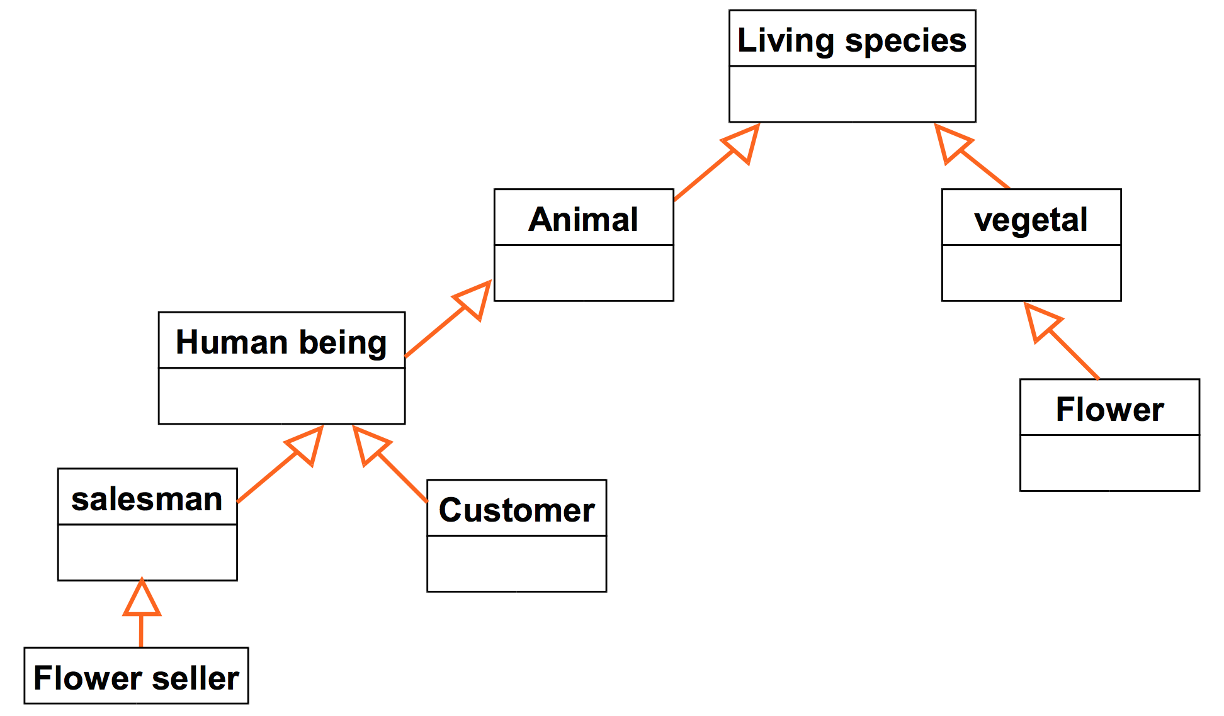
Inheritance
In Java, a class can inherit attributes and methods from another class.
The class that inherits the properties is known as the sub-class or the child class.
The class from which the properties are inherited is known as the superclass or the parent class.
In Inheritance, the properties of the parent class (attributes and methods) are acquired by the derived classes.

Slide 23
Was it possible before?
// namedPoint.h
struct NamedPoint;
struct NamedPoint* makeNamedPoint(double x, double y, char* name);
void setName(struct NamedPoint* np, char* name);
char* getName(struct NamedPoint* np);
// namedPoint.c
#include "namedPoint.h"
struct NamedPoint {
double x,y;
char* name;
};
struct NamedPoint* makeNamedPoint(double x, double y, char* name) {
struct NamedPoint* p = malloc(sizeof(struct NamedPoint));
p->x = x;
p->y = y;
p->name = name;
return p;
}
void setName(struct NamedPoint* np, char* name) {
np->name = name;
}
char* getName(struct NamedPoint* np) {
return np->name;
}
#include "point.h"
#include "namedPoint.h"
#include <stdio.h>
int main(int ac, char** av) {
struct NamedPoint* origin =
makeNamedPoint(0.0, 0.0, "origin");
struct NamedPoint* upperRight =
makeNamedPoint(1.0, 1.0, "upperRight");
printf("distance=%f\n", distance(
(struct Point*) origin,
(struct Point*) upperRight));
}

Slide 24
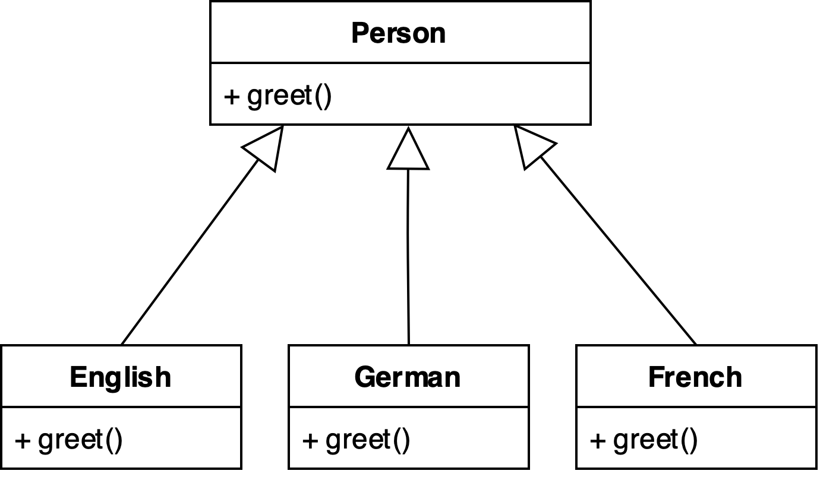
Polymorphism
Inheritance lets us inherit attributes and methods from another class.
Polymorphism enables inherited methods to perform the same operation in different ways.
Tell-Don’t-Ask principle: instead of asking an object about its state and then performing actions, it’s much easier to simply tell the object what it needs to do and let it decide for itself how to do that.

Slide 25
Was it possible before?
#include <linux/fs.h>
struct file_operations {
struct module *owner;
loff_t (*llseek) (struct file *, loff_t, int);
ssize_t (*read) (struct file *, char __user *, size_t, loff_t *);
ssize_t (*write) (struct file *, const char __user *, size_t, loff_t *);
[...]
long (*unlocked_ioctl) (struct file *, unsigned int, unsigned long);
[...]
int (*open) (struct inode *, struct file *);
int (*flush) (struct file *, fl_owner_t id);
int (*release) (struct inode *, struct file *);
[...]
https://linux-kernel-labs.github.io/refs/heads/master/labs/device_drivers.html

Slide 26
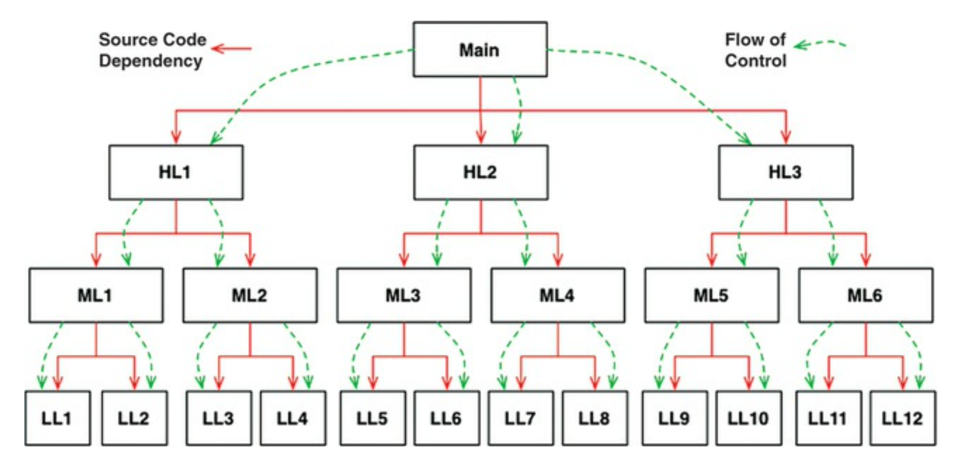
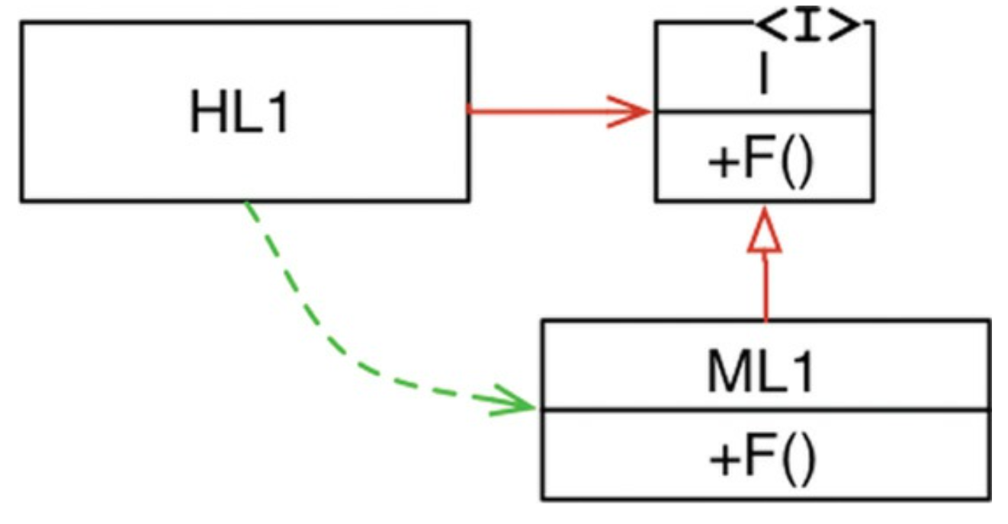
So What?
OO is the ability, through the use of polymorphism, to gain absolute control over every source code dependency in the system.
It allows the architect to create a plugin architecture, in which modules that contain high-level policies are independent of modules that contain low-level details.
The low-level details are relegated to plugin modules that can be deployed and developed independently from the modules that contain high-level policies.

Slide 27
Wrapping up
Cooperative development
Different people working on different classes
Incremental design and development
Define new classes by extending the exsisting ones
Code management
Bugs on object data are easier to spot. Since data are not visible from the outside, errors mostly occurs in the object handling the data
Changes on a specific class do not impact other classes (unless external interface is modified)
Needs a Object Oriented way of thinking
Complex design (e.g., Which classes?, How many classes?)
Benefits only occur in large programs
Programs < 1K lines, spaghetti code is still understandable and fast to write
Programs > 10K lines, spaghetti code is almost inevitable

Slide 28
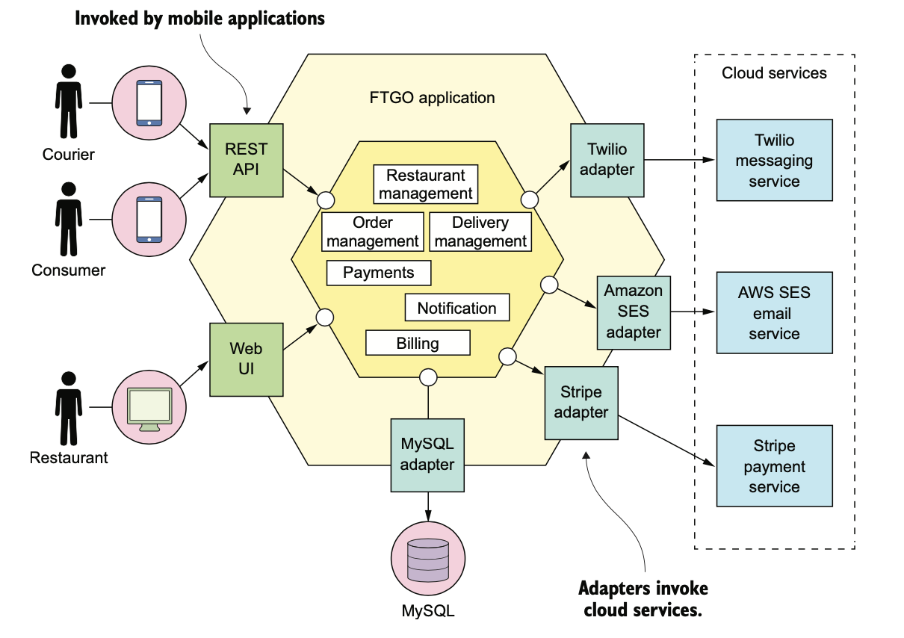
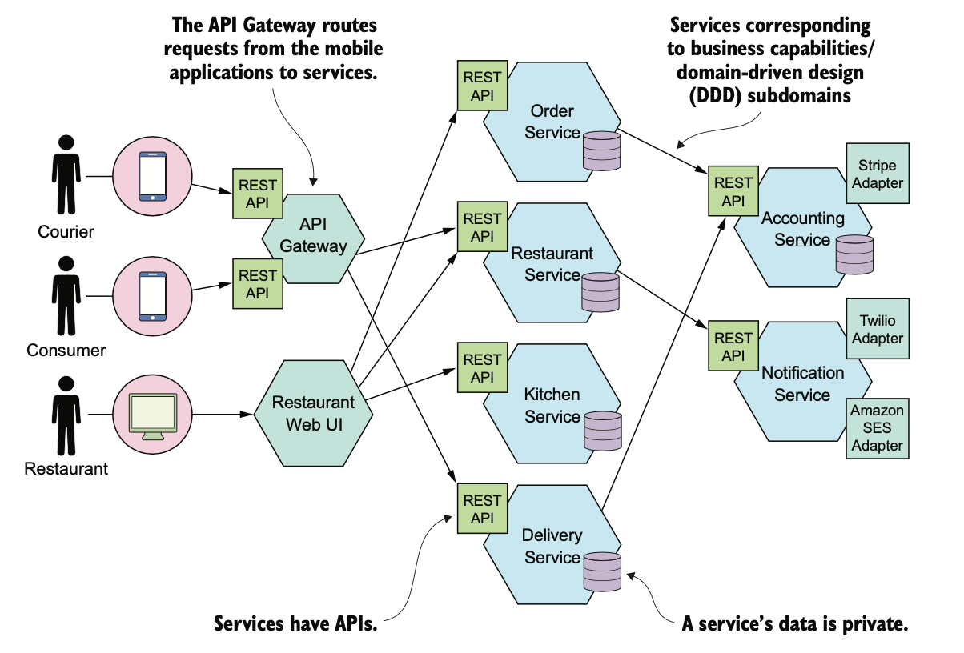
Is OOP the end?

Slide 29
Wisdom Pills
Learning to write clean code is hard work. It requires more than just the knowledge of principles and patterns. You must sweat over it. You must practice it yourself, and watch yourself fail. You must watch others practice it and fail. You must see them stumble and retrace their steps. You must see them agonize over decisions and see the price they pay for making those decisions the wrong way. -- Clean Code, Robert C. Martin

